Slide 1

Diabetes Prediction-Feature Selection
based on questionnaire

Slide 2
Project Statement
Non-Profit Organization providing a simple questionnaire (without intricate biomarkers) to monitor the tendency of the residents of the Aegean Islands for type II Diabetes
Suggestions of lifestyle changes
Future utilization for medical purposes

Slide 3

CDC Diabetes Health Indicators
22 features 253680 rows
Diabetes diagnosis - Demographics (age, sex)
Personal information (income, educations)
Health history (drinking, smoking, mental health, physical health,BMI)

Slide 4
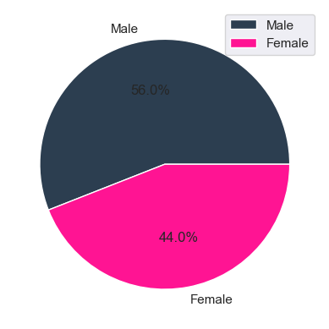
Gender characerisics

Slide 5
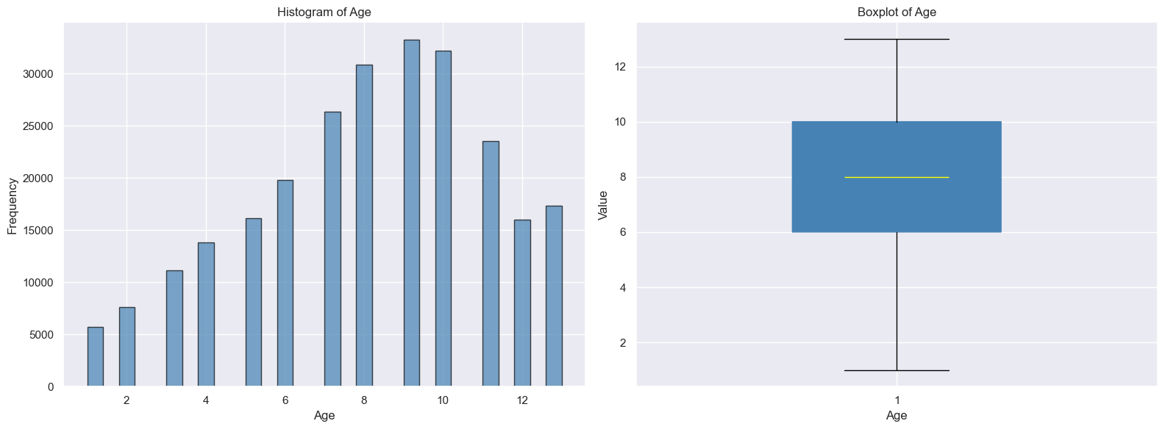
Age Groups

Slide 6
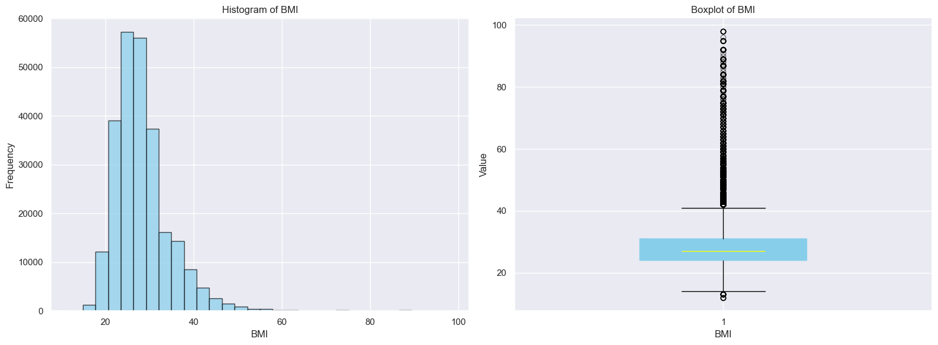
BMI

Slide 7
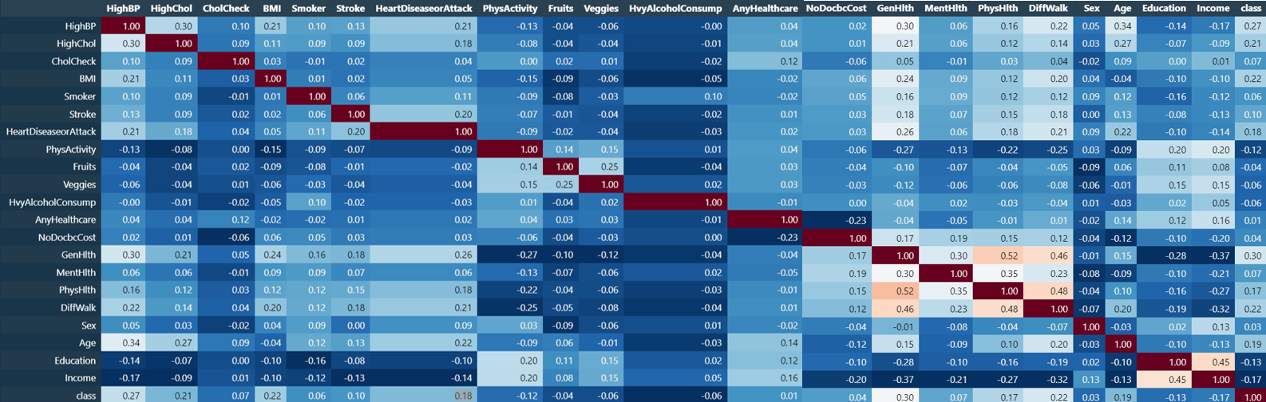
Feature Correlations
No extreme correlations observed

Slide 8

Model Evaluation
RF -- 0.84 Recall F1-score – 0.82
LR -- 0.84 Recall F1-score – 0.82
Top 10 Features
RF -- 0.80 Recall F1-score – 0.81
LR -- 0.85 Recall F1-score – 0.82
PCA
RF -- 0.84 Recall F1-score – 0.81
LR -- 0.82 Recall F1-score – 0.82

Slide 9
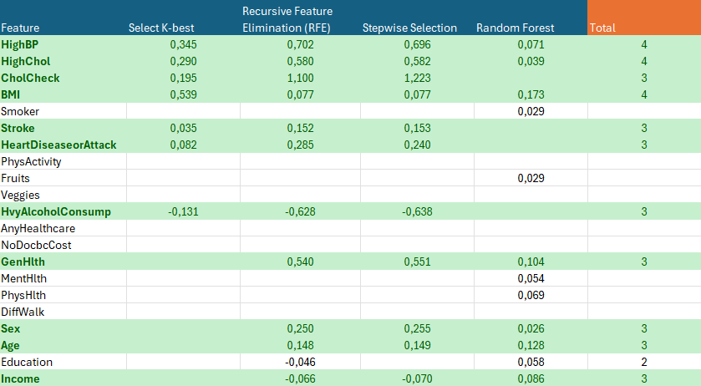
Feature Selection

Slide 10
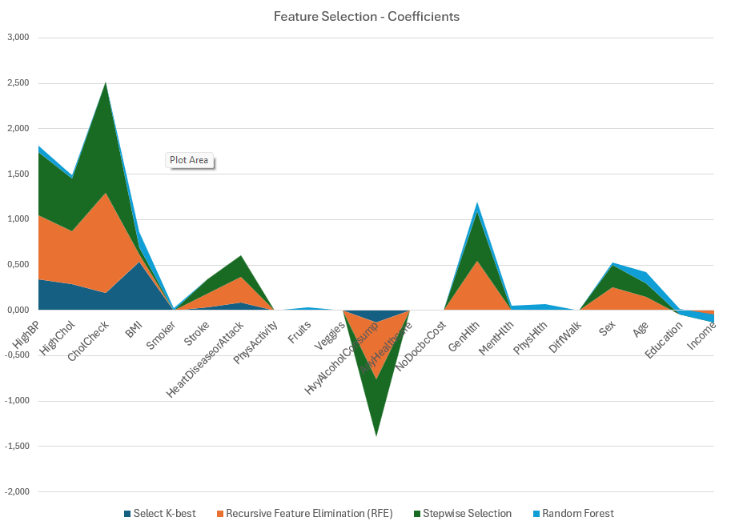

Slide 11

Healthcare data – Privacy concern
Analysis Without Differential Privacy: An attacker who gains access to the results could reverse-engineer the data to identify individuals' medical conditions.
Analysis With Differential Privacy: The attacker would see results that include random noise.

Slide 12
Sensitive Data Susceptible to
Membership Inference Attacks
Model Inversion Attacks

Slide 13
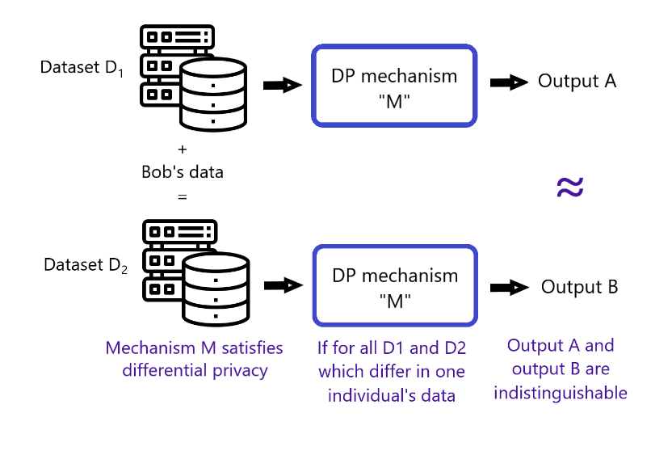
Outcomes

Slide 14

Differential Privacy Models
LR,DT ,NB from diffprivlib to protect from model attacks
Differentially private NB 0.72 Recall 0.71 F1-Score
Much lower scores for DP LR
as compared to LR

